Slide 1
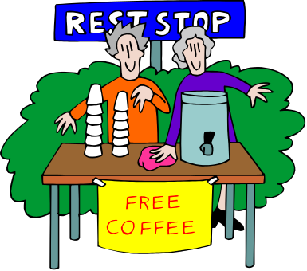
VOLUNTEER MANAGEMENT
A “S.W.O.T” Analysis
Strength, Weakness, Opportunity
and
Threat

Slide 2

Strengths aka: What Volunteers Need
Good, open, and concise communication about responsibilities, commitment, and authority
Strong leadership in the form of a chain of command that allows them a feeling of protection and acknowledgement.
Clear and well defined protocols for actions and behavior-concerning both volunteer and supervisor.

Slide 3

Why Strengths are important
Volunteering is scary for a lot of people. It’s a step outside a comfort zone and most need a lot of hand-holding and reassurance.
We have all had bad volunteering experiences where we felt our time was wasted, unappreciated, or dismissed.
The emphasis needs to be put on taking care of the volunteer and making them feel as at ease with the project as is possible. If that means personal attention-then that’s what it means.

Slide 4

3 Key Reasons You Need a System of Protocol
It is long lasting and goes beyond any one person at any one time.
It provides a feeling of security and trust for the volunteer and the supervisor.
It removes the somewhat arbitrary nature of volunteering and gives it validity.

Slide 5

WEAKNESS:
What Will Make You Fail
Pretty much the exact opposite of every thing we have just covered!
CLOUDY COMMUNICATION: No one, including us, has a clue about what is actually and/or should be taking place.
LACKING LEADERSHIP: Volunteers feel lost and unsupported and fellow team members feel tension and resentment.
RELAXED RULES: No protocol means no recourse when accidents or problems arise.

Slide 6

Why We Need to be Honest About Our Weaknesses!
There does not need to be any labeling, recrimination, or degrading--just honesty.
You have to name it to claim it-or so says Dr. Phil. Until you put a voice to your concerns and problems, there is no chance of fixing them.
Knowing our weaknesses helps us prepare to avoid them and prevent others from taking advantage of them.

Slide 7

Opportunities: The “O” in the Dyslexic SWOT Analysis
Opportunities involve and include the areas of the community at large that our programs can benefit from.
Examples are: universities, senior organizations, corporations, other NPOs.
The time, money, and skill base of all of these examples can be invaluable sources to explore for the purpose of Volunteer Recruitment.

Slide 8


THREATS! Dum dun dunnnn!
Threats are the external factors that can inflict damage or cause failure for a project.
Examples are: timing (such as too late in the semester for a school project), competition (another NPO beat us to the punch) or volunteer fatigue (esp. at the holiday season or summer)
These are variables not necessarily able to be controlled by the reach of typical volunteer management; But they DO need to be taken into consideration in a planning stage.

Slide 9


What Have We Learned?
Planning is everything! From start to finish of a project every eventuality needs to be considered and there needs to be support in place to attend to that need.
In planning, there needs to be realistic expectations. This would incorporate some honest evaluation of resources and ability.
The focus needs to be on what we can do for the volunteer and NOT what the volunteer can do for us. We cater to them-not the other way around.

